Slide 1
Accessing Internet and Netizen Community Standards

Slide 2
What is Internet?
Features of Internet
Accessibility
Low Cost
Flexibility of Communication
Easy to use

Slide 3
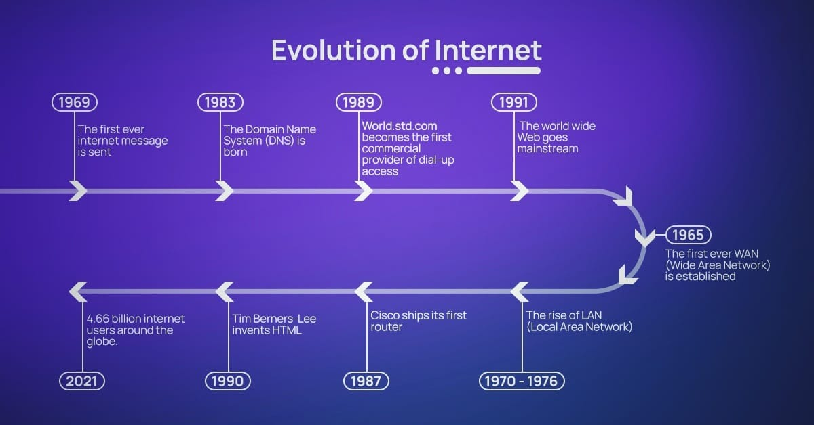
Origin of Internet

Slide 4
Advantages of Internet
Online Education
Global Connectivity
Cloud Computing and Storage
Promotions and Advertising
Endless Entertainment
Jobs and freelancing

Slide 5
Medium of Accessing Internet
The way or path we use to access the internet is called the medium of accessing the internet.
Generally, we see two types of medium:
Wireless
Wired

Slide 6

Wireless

Slide 7
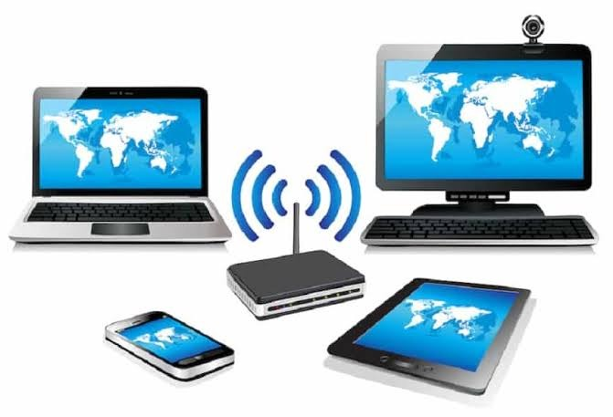
Examples of wireless device:
Smartphone
Laptop
Smart watch
Smart TV
Tablet

Slide 8
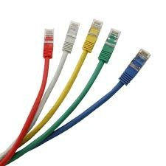
Wired
In wired medium the primary required device is modem.
Most used Cables — such as Cat5, Cat6, and so on — are used to tether a device to an internet router and transfer data.

Slide 9
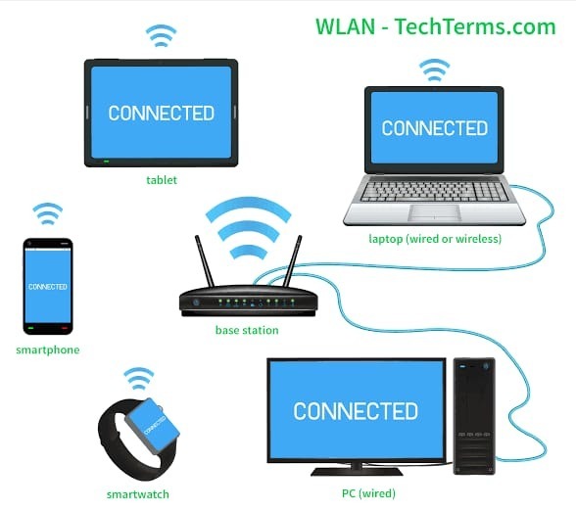
Most used wired cables are:
Dial up
Cable internet
DSL (digital subscriber line)
Fiber -optic communication
Most used wired device is desktop computer.

Slide 10
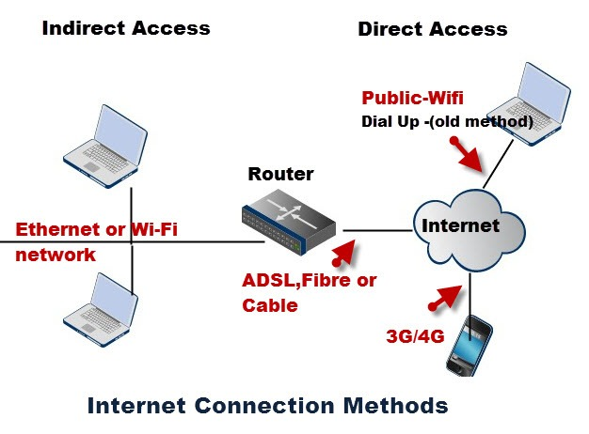
How to Access Internet?

Slide 11
There are two access methods direct and Indirect and these can be either fixed or mobile.
Indirect Access:
This is most common method used in home and office networks.
The device e.g. computer connects to a network using Ethernet or Wi-Fi and the network connects to the Internet using ADSL, cable or fiber.
Direct Access:
This is most common method used when travelling.
The device e.g. smart phone connects directly to the Internet using 3G/4G mobile networks or public Wi-Fi.

Slide 12

3 basic requirements to access Internet. There are three ingredients needed to access Internet from a laptop or desktop computer:
An ISP
A modem
A web browser

Slide 13
Presentation outcomes:-
What is Netizen?
Legal rights and duties of netizen.
E-governance and netizen
What is Community Standard?
Common Netizen Community Standards
What if a netizen violates community standards

Slide 14


There have no legal definition of netizen.
Net + citizens = Netizen
Generally speaking, a person work in net and who is active on net is called netizen.

Slide 15
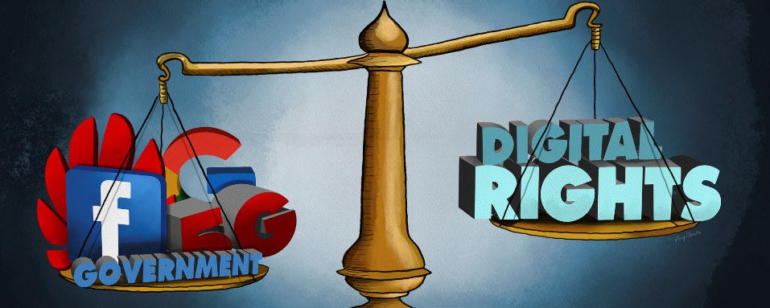
Legal rights and duties of a netizen.
Rights
Duties
Freedom of speech and expression.
Right to information.
Right to dignity and privacy.
Not to violate privacy, or instigate hatred.
Generating positive data.
Report the abuse.

Slide 16

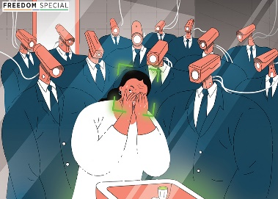
E-governance and netizen
Right to life and forgotten
Generating sensitive personal data for governance purposes
Service, delivery and consumption

Slide 17
What is community standards
Community Standards are written to ensure that everyone’s voice is valued and Facebook takes great care to craft policies that are inclusive of different views.

Slide 18
Common Netizen Community Standards:
RIGHTS:
Authenticity
Safety
Privacy
Dignity
DUTIES:
Violence & Criminal Behavior
Objectionable Content
Respecting Intellectual Property

Slide 19
What if a netizen violates community standards?
Information, Communication & Technology Act 2006
Digital Security Act 2018
The Pornography Control Act, 2012

Slide 20
Thank You!

